Slide 1



Common patterns of "healthy" brain ageing and their relevance for neurological and psychiatric disorders
Max Korbmacher
Western Norway University of Applied Sciences, Bergen
Email: Max.Korbmacher@hvl.no
Twitter: @KorbmacherMax

Slide 2
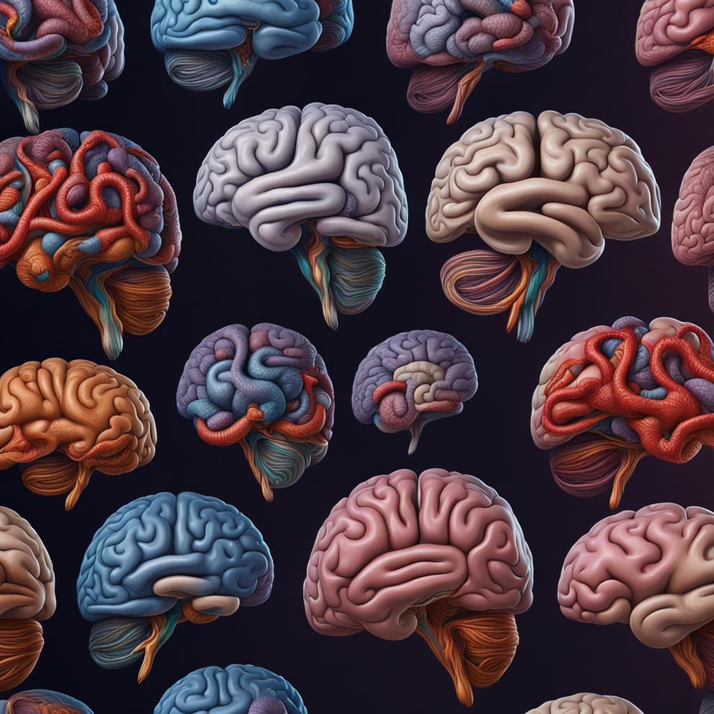
What I will talk about today
Background
Results
Conclusions
I. BACKGROUND
Ageing as a normative process
Brain age
II. BRAIN AGE(ING)
White matter ageing
Brain asymmetry
Brain age: advances & challenges
III. TRANSLATABILITY?

Slide 3
I. BACKGROUND

Slide 4
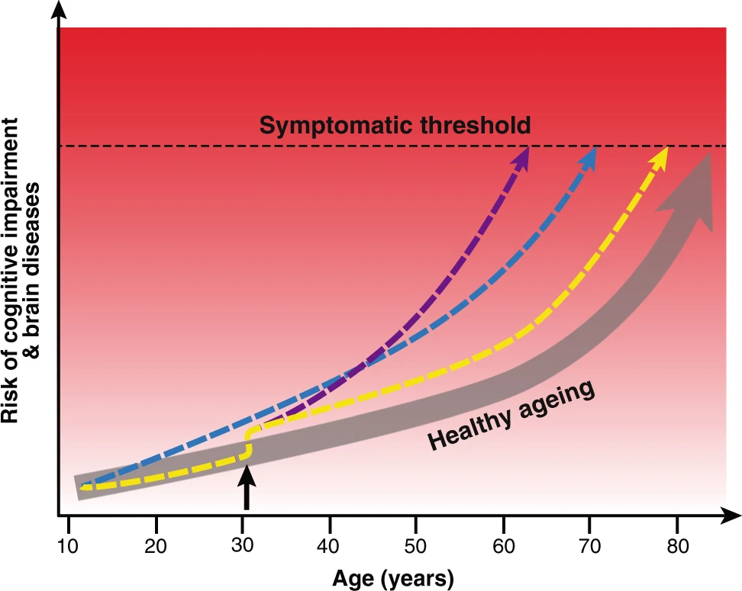
1. Ageing as a normative process
Background
Results
Conclusions
Brain physiology can be described through normative curves
Deviations are informative of disorders
Cole et al., Nat.Mol.Psych., 24 (2019)

Slide 5
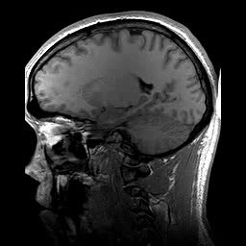
2. Brain age
Background
Results
Conclusions
Brain age gap (BAG)
Predict a person’s age from a set of MR data features: “Your brain is X years old”
Calculate the difference between chronological and predicted age
BAG associations
Related with a multiple phenotypes, clinical symptoms and diagnoses¹
The larger the physiological expression (e.g., neurodegen.), the bigger the BAG
Chronologically 22 years old
Age prediction
Biologically 28 years old
BAG = 6 years
1 Franke & Gaser, 2019, Front. Neurol., 789

Slide 6
II. BRAIN AGE(ING)

Slide 7
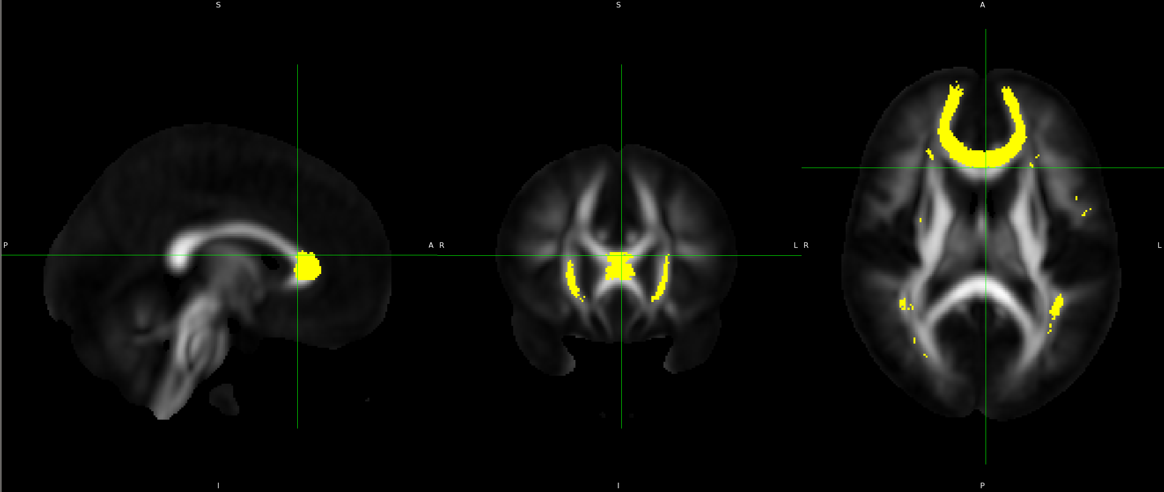
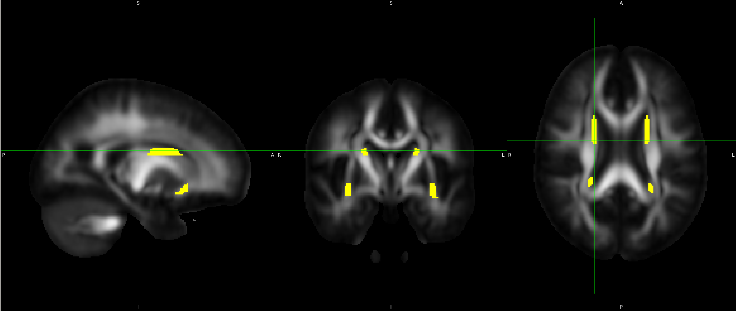
3. White matter ageing
Background
Results
Conclusions
Most important features for white matter brain age predictios in UK Biobank (N = 35,749): fornix & forceps minor¹
These regions were also outlined in mass correlations of brain features & age
1 Korbmacher et al., 2023, Hum. Brain Map. 44(10)

Slide 8
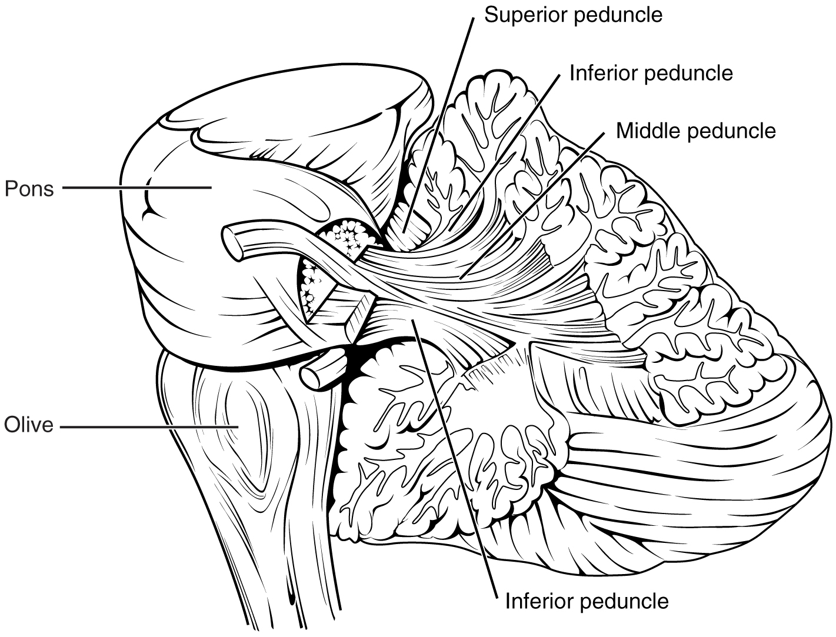
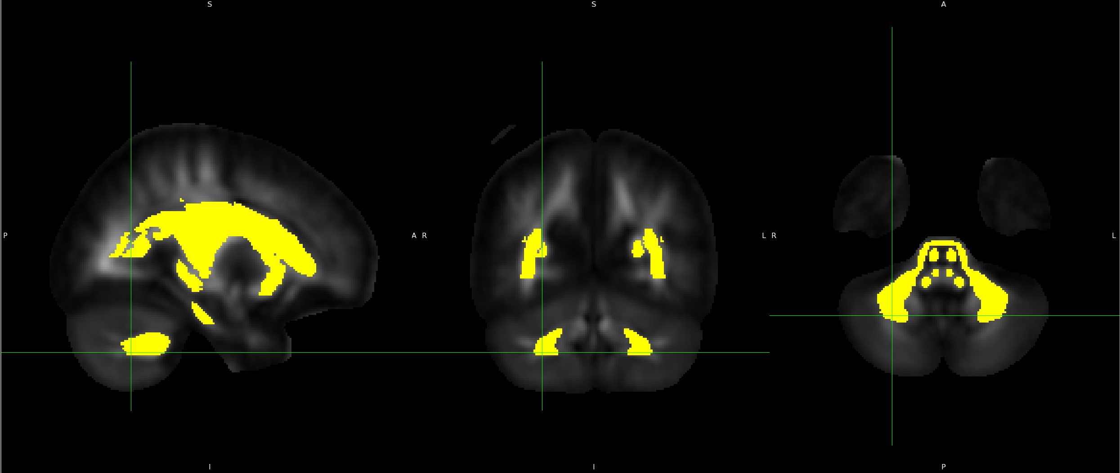
3. White matter ageing
Background
Results
Conclusions
Longitudinal data (UK Biobank: N = 2,329) confirm ageing of fornix & forceps minor¹
Additionally cerebellar peduncle
1 Korbmacher et al., 2023, biorxiv

Slide 9
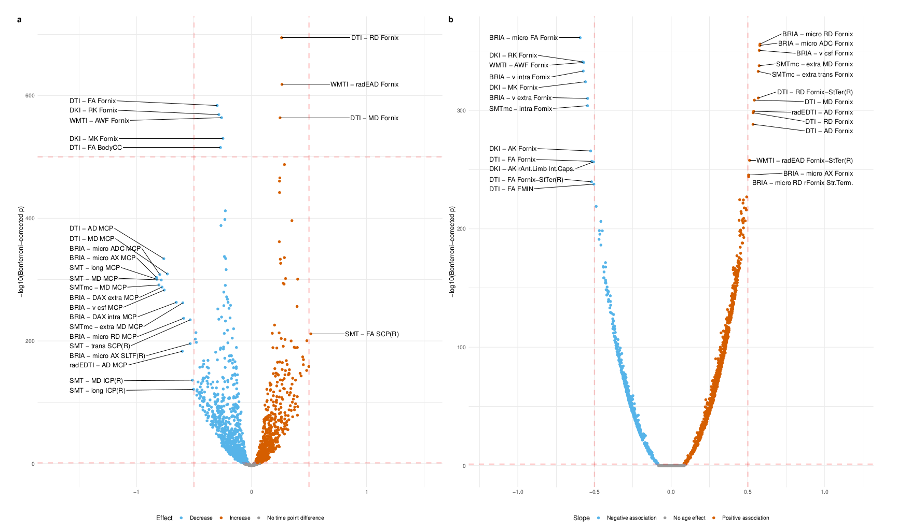
3. White matter ageing
Background
Results
Conclusions
Longitudinal data confirm ageing of fornix & forceps minor¹
Additionally cerebral peduncle
1 Korbmacher et al., 2023, biorxiv

Slide 10
3. White matter ageing
Background
Results
Conclusions
Longitudinal data confirm ageing of fornix & forceps minor¹
Additionally cerebral peduncle
Annecdotal evidence for cerebral peduncle associations with Alzheimer’s polygenic risk score (yet small associations between PGRS & disorders)
Accelerated ageing at older age
1 Korbmacher et al., 2023, biorxiv

Slide 11
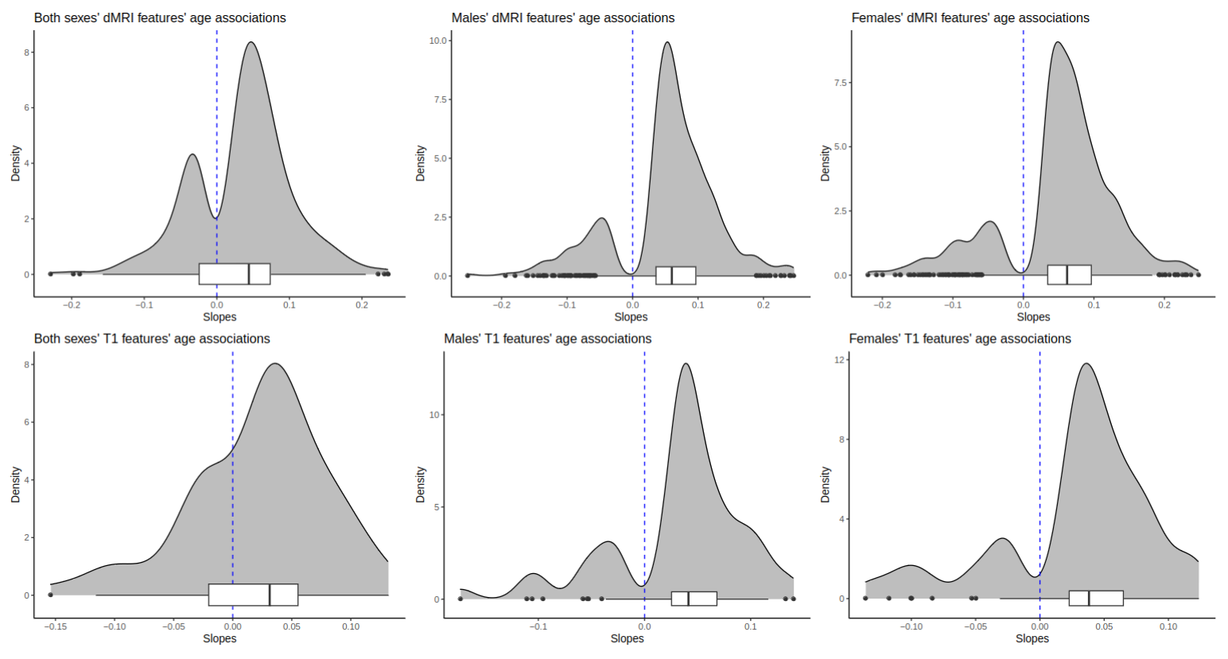
4. Asymmetry
Background
Results
Conclusions
Previously outlined deep and low grey and white matter structures show the largest age-sensitivity
Asymmetry appears larger in senescence
Significant Slopes of linear relationships of absolute feature assymmetry & age
1 Korbmacher et al., 2024, Nat. Comm. (accepted)

Slide 12
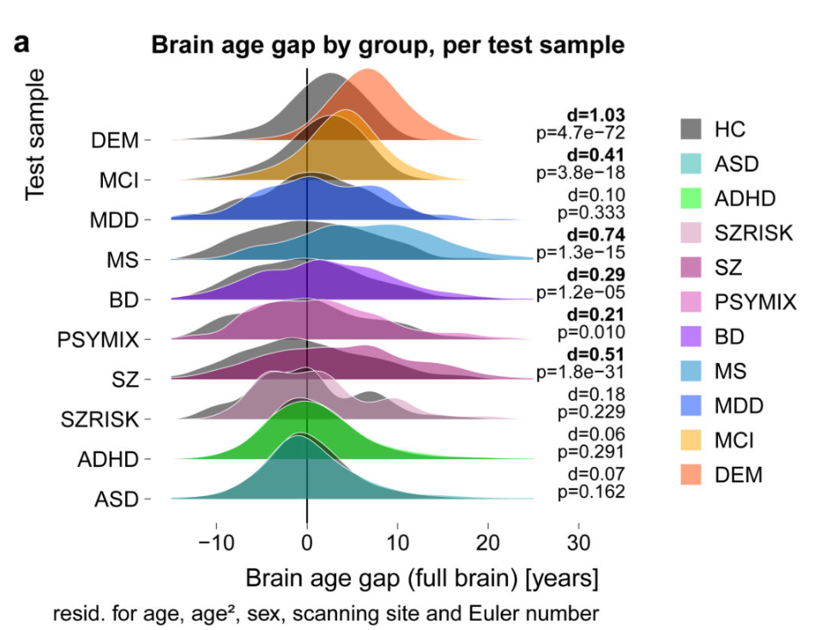
5. Brain age
Background
Results
Conclusions
(Grey matter) brain age associated with brain and psychiatric disorders¹
Particularly neurodegenerative disorderts
1 Kaufmann et al., 2019, Nat. Neurosci. 22(10)

Slide 13
5. Brain age
Background
Results
Conclusions
(White matter) brain age associated with bio-psycho-social variables¹
Particularly cardiometabolic health indicators
waist-to-hip ratio, hypertension, vascular diagnosis, pulse pressure
And cognitive functioning
Matrix puzzle solving
Phenotypes which reflect ageing are associated with brain age.
1 Korbmacher et al., 2023, Front. Psych. 14

Slide 14
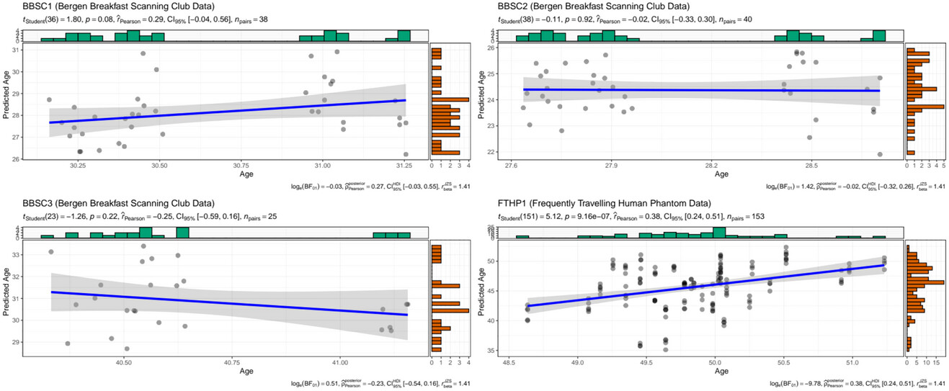
5. Brain age
Background
Results
Conclusions
Precision estimates for single subjects not possible, Brain age suffers from large prediction error
Korbmacher et al., 2023, Brain & Beh. 13(10)

Slide 15
III. TRANSLATABILITY

Slide 16
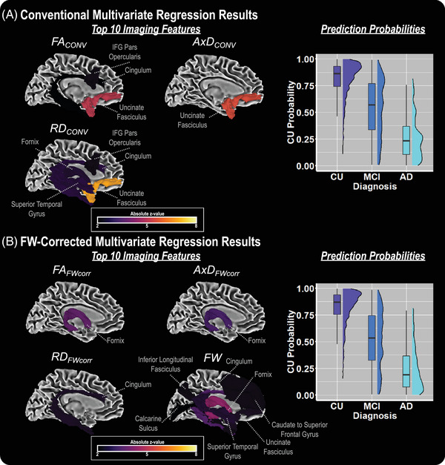
Can we clinically translate the findings?
Concepts
Results
Conclusions
Deep and low brain structures are related to age(ing)
The same (limbic) structures age differently in Alzheimer’s disease (see Fig., N = 1,607)
Yang et al., 2023, Alz. Dem. 15(2)

Slide 17
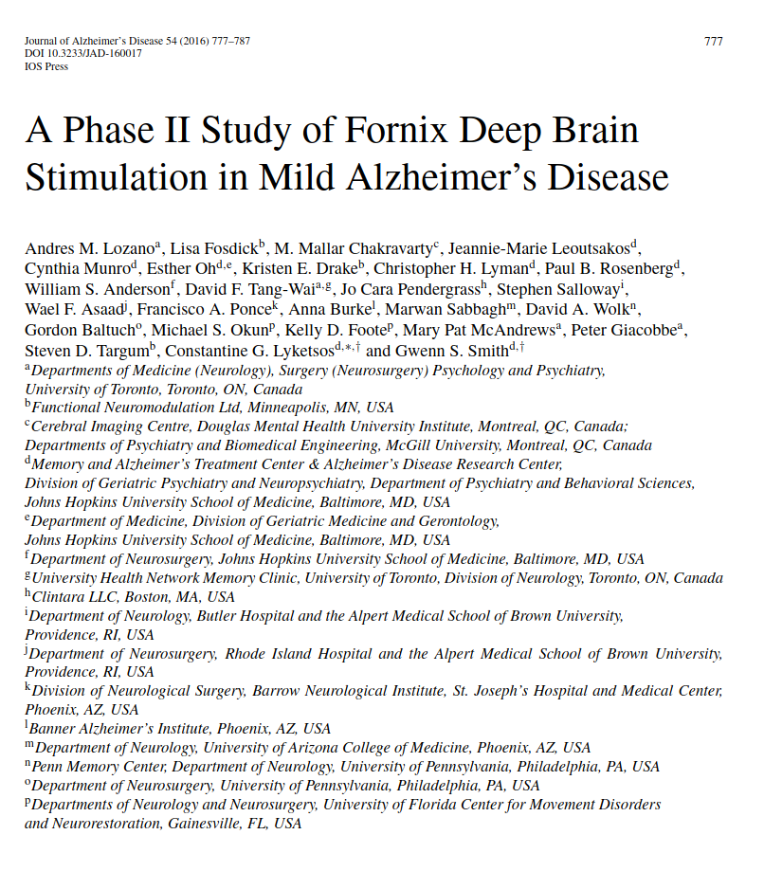
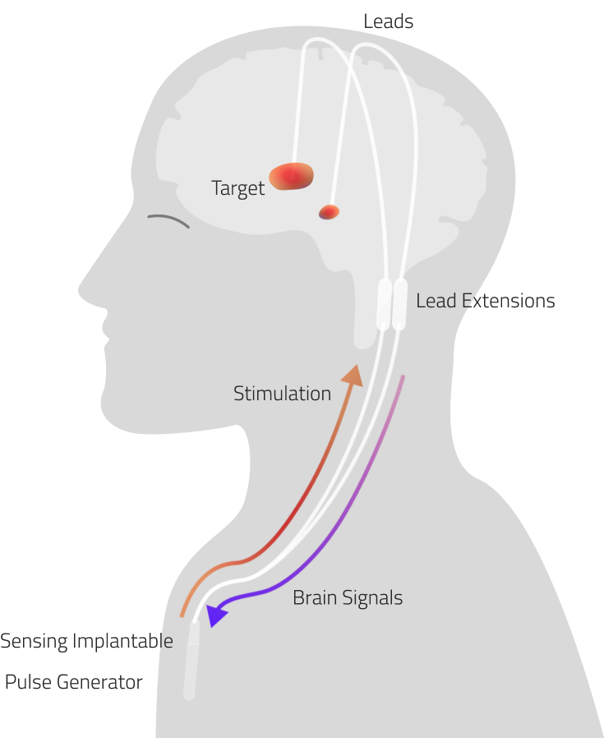
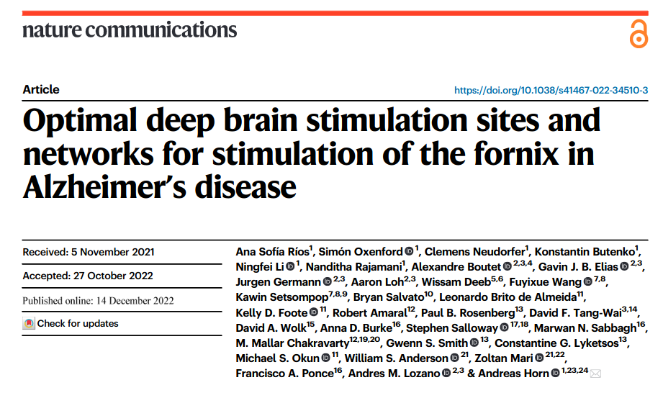
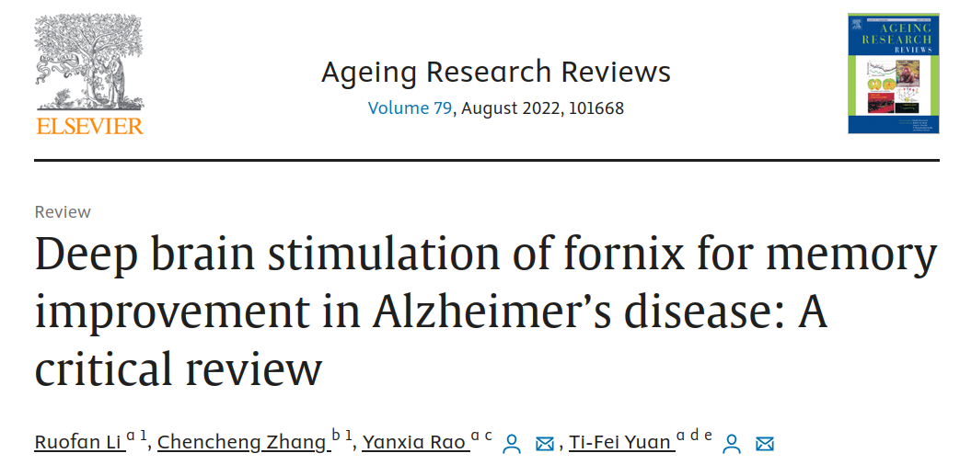
Can we clinically translate the findings?
Concepts
Results
Conclusions
Fornix is already a target region for deep brain stimulation in Alzheimer’s

Slide 18
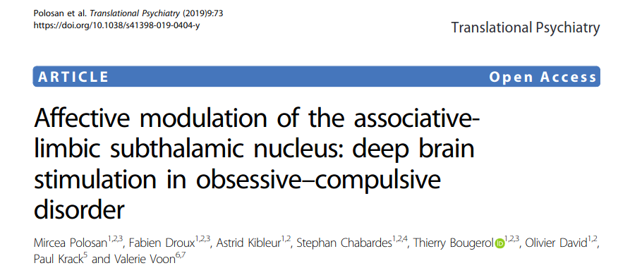
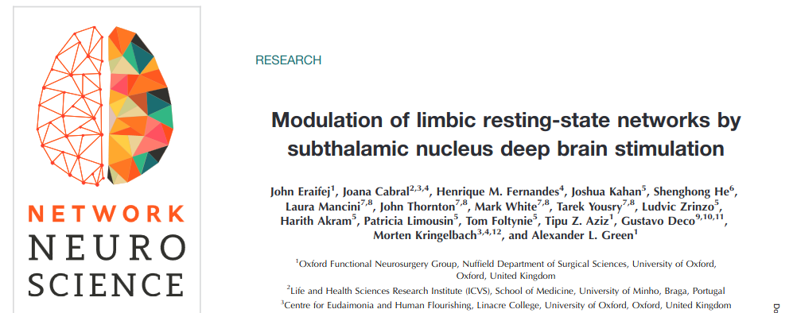
Can we clinically translate the findings?
Concepts
Results
Conclusions
Emerging evidence for associative-limbic subthalamic nucleus DBS for OCD and Pakinson’s treatment

Slide 19

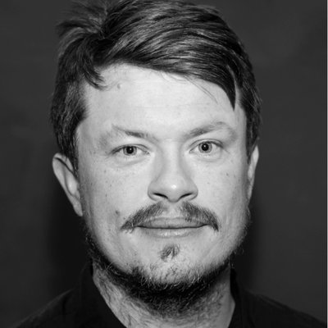
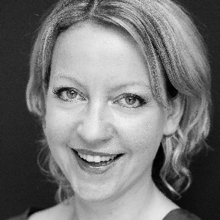
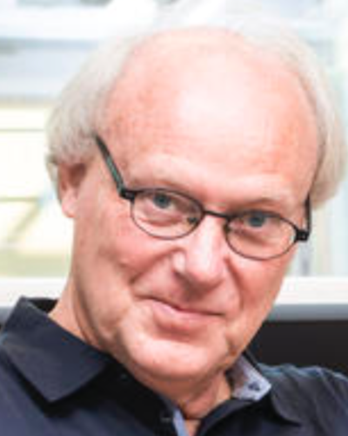
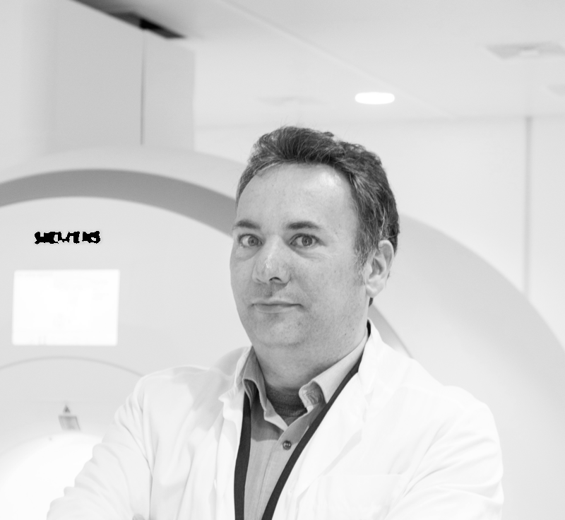
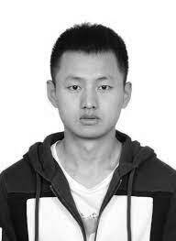



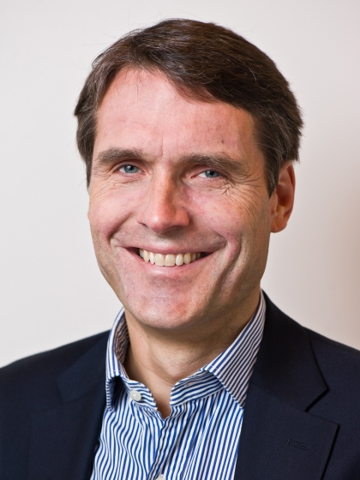
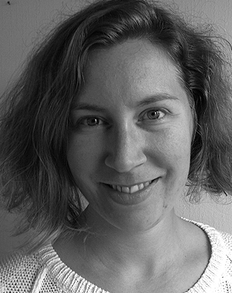
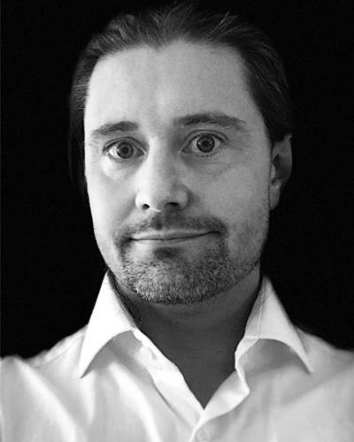
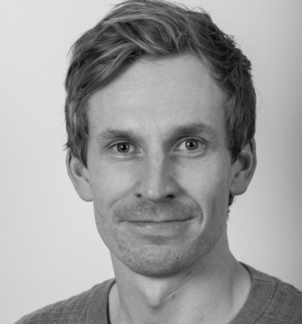
Ivan I. Maximov
Lars T. Westlye
Eli N. Eikefjord
Arvid Lundervold
Karsten Specht
Meng-Yun Wang
Thomas Espeseth
Ralph Buchert
Daniel E. Askeland-Gjerde
Thank you!
Dennis van der Meer
Ann Marie de Lange
Dani Beck
Ole A. Andreassen
Tiril Gurholt
Rune Eikeland
Esten Leonardsen

Slide 20
Questions?
How to contact me:
Email: Max.Korbmacher@hvl.no
Twitter: @KorbmacherMax

